Slide 1
Topics in Data Science 2
Git Workflow

Slide 2
Agenda
Session objectives
What is version control?
<objective 1>
<objective 2>
<…>
Setting up git
Create your first repository
TDS workflow

Slide 3
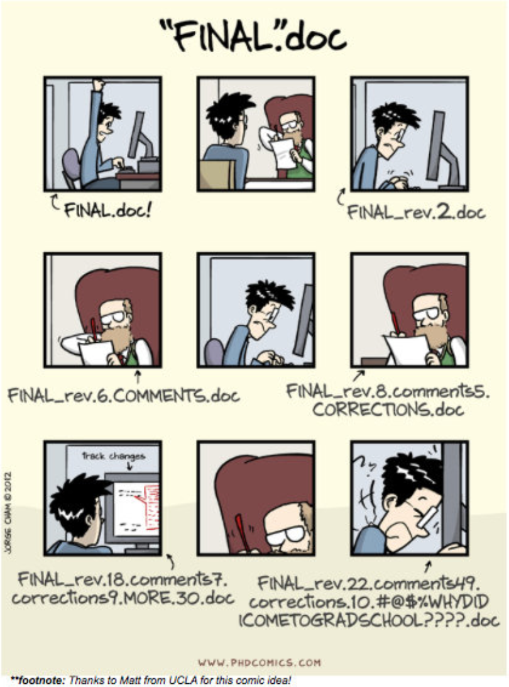
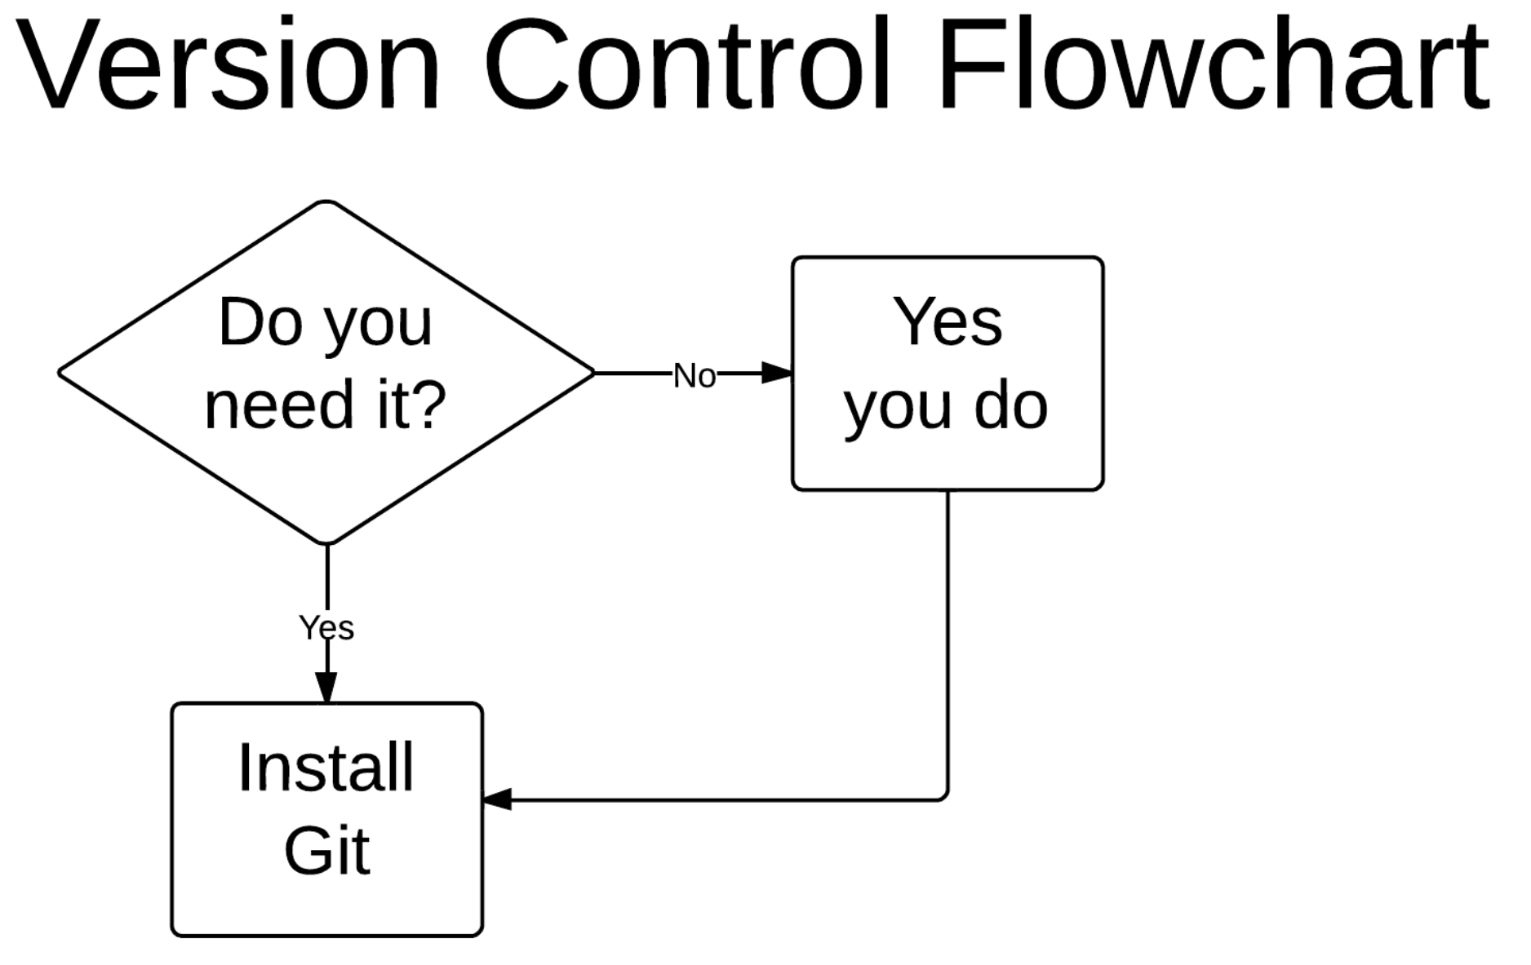
Why do we need version control?

Slide 4
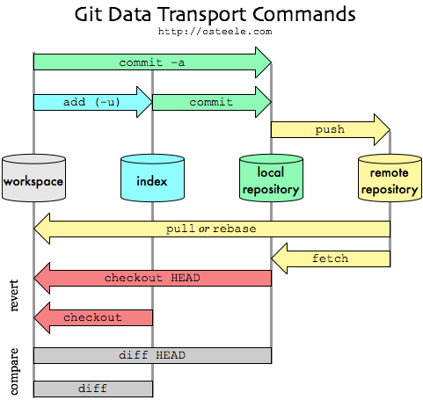
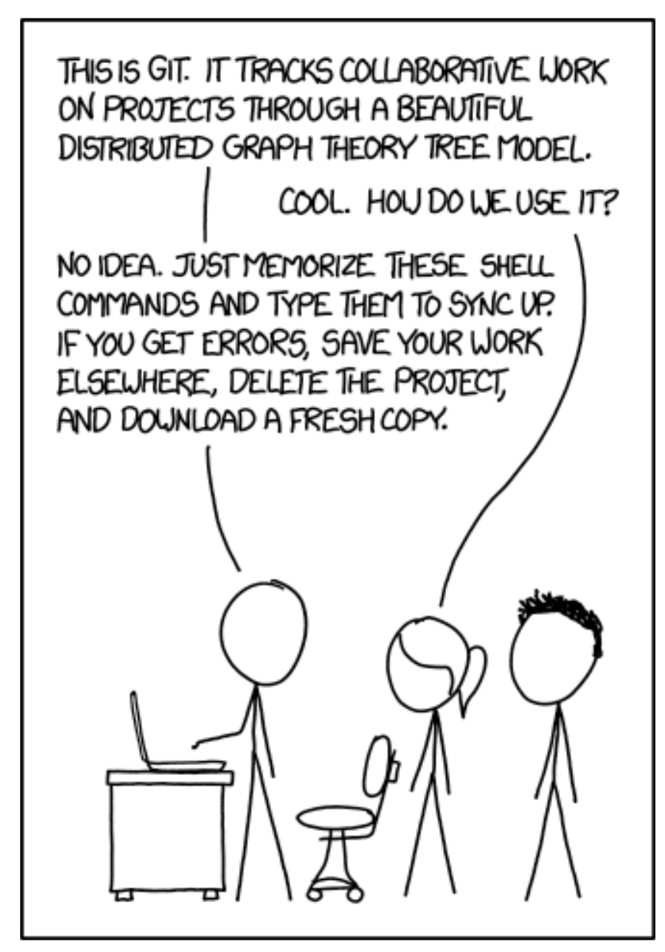
How does it work?

Slide 5
Agenda
Session objectives
What is version control?
<objective 1>
<objective 2>
<…>
Setting up git
TDS workflow

Slide 6
Install git
A very good tutorial:
https://happygitwithr.com/install-git.html
Install Git for Windows:
https://gitforwindows.org
NOTE: When asked about “Adjusting your PATH environment”, make sure to select “Git from the command line and also from 3rd-party software”. Otherwise, we believe it is good to accept the defaults.
The same very good tutorial:
https://happygitwithr.com/install-git.html
Install Git for Mac:
Go to the Terminal and and install the Xcode command line tools (which include git) by entering:
“xcode-select –install”
Or if you use Homebrew:
“brew install git”

Slide 7
Configure Git
On Windows:
Enter the Git Bash shell
On Mac and Linux:
Enter the shell
Configure your git:
git config --global user.name “Max Mustermann”
git config --global user.email “max.mustermann@mail.com”

Slide 8
Agenda
Session objectives
What is version control?
<objective 1>
<objective 2>
<…>
Setting up git
TDS Workflow

Slide 9
The TDS repository
We provide a repository for our class at:
https://github.com/tds2024-25/course
We will use this repository to upload:
Jupyter Notebooks from the lectures
Solutions for the assignments
Interesting and helpful stuff

Slide 10
Assignment Submission Workflow
You will have to work on assignments to qualify for the (graded) capstone project
Assignments are submitted via GitHub pull requests
To work on your assignment, you have to create your own fork on GitHub:
Click on the assignment in WueCampus classroom
Login using GitHub Account
Join the GitHub classroom by clicking on your name
Accept the assignment
Wait for GitHub classroom to configure your repository and click on the link
Create a new branch named assignment_xyz

Slide 11
Assignment Submission Workflow (Google Colab)
We recommend that you work on your assignments using Google Colab
To modify and submit your assignments via Google Colab:
Click on the Google Colab link in your GitHub repository
Click on “File/Open Notebook”
Click on GitHub
Search for “tds2024-25”
Select your repository and Branch and open the notebook
Make changes
Click on “File/Save to github”
Select your repository and Branch and add a commit message
Create a pull request (DON’T MERGE IT)

Slide 12
Assignment Submission Workflow (Local)
Of course, you don’t have to use Google Colab for your submissions. Follow this steps to submit your assignments if you prefer working local:
Clone your repository
Move into the repository’s folder
Fetch all branches and checkout assignment_xyz
Work on the assignment and push changes to branch
Create a pull request (DON’T MERGE IT)

